Slide 2
Study Goals
Objective : by making the pretzel supplier change, are we at risk of alienating heavy users of the product?
Key questions:
Are the Treehouse pretzels alienating to the consumers?
Overall consumer perception of the Micro Mini and Stick Pretzels in the mix.

Slide 3
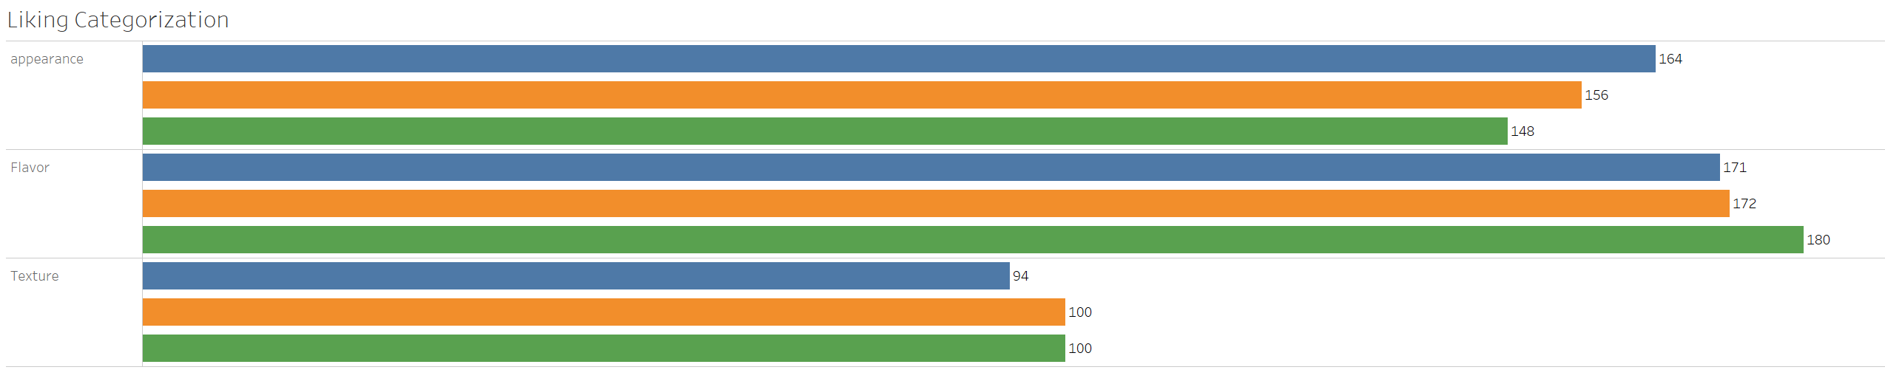
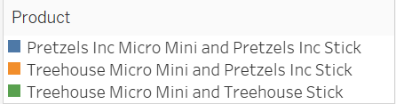
Liking – Topic categorization
Notes:
4 responses excluded – 3 of those said they didn’t like, 1 was in neither like or disliked (Q – q4 – Overall Liking)

Slide 4
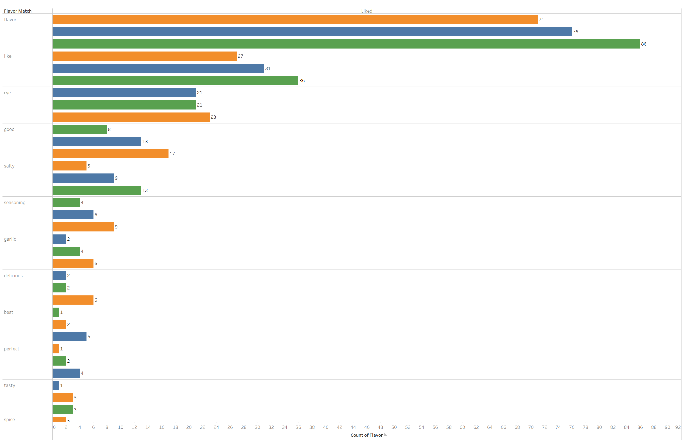
Topic Wise Breakdown – Flavor (Overall Liking)

Slide 5
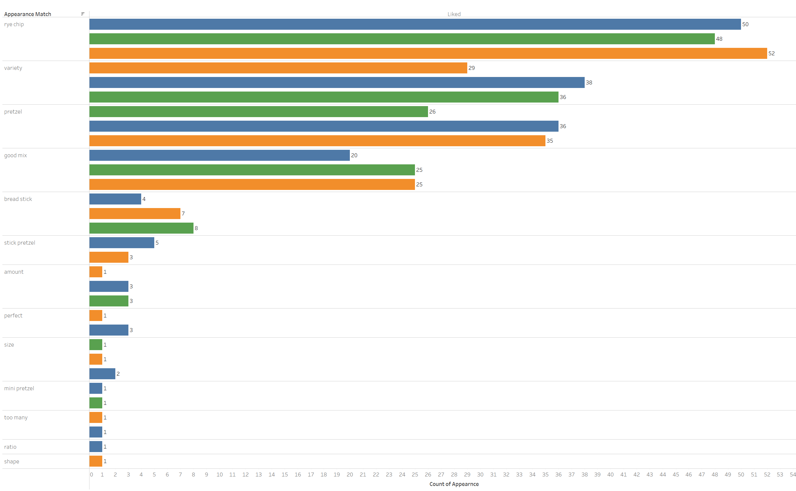
Topic Wise Breakdown – Appearance (Overall Liking)

Slide 6
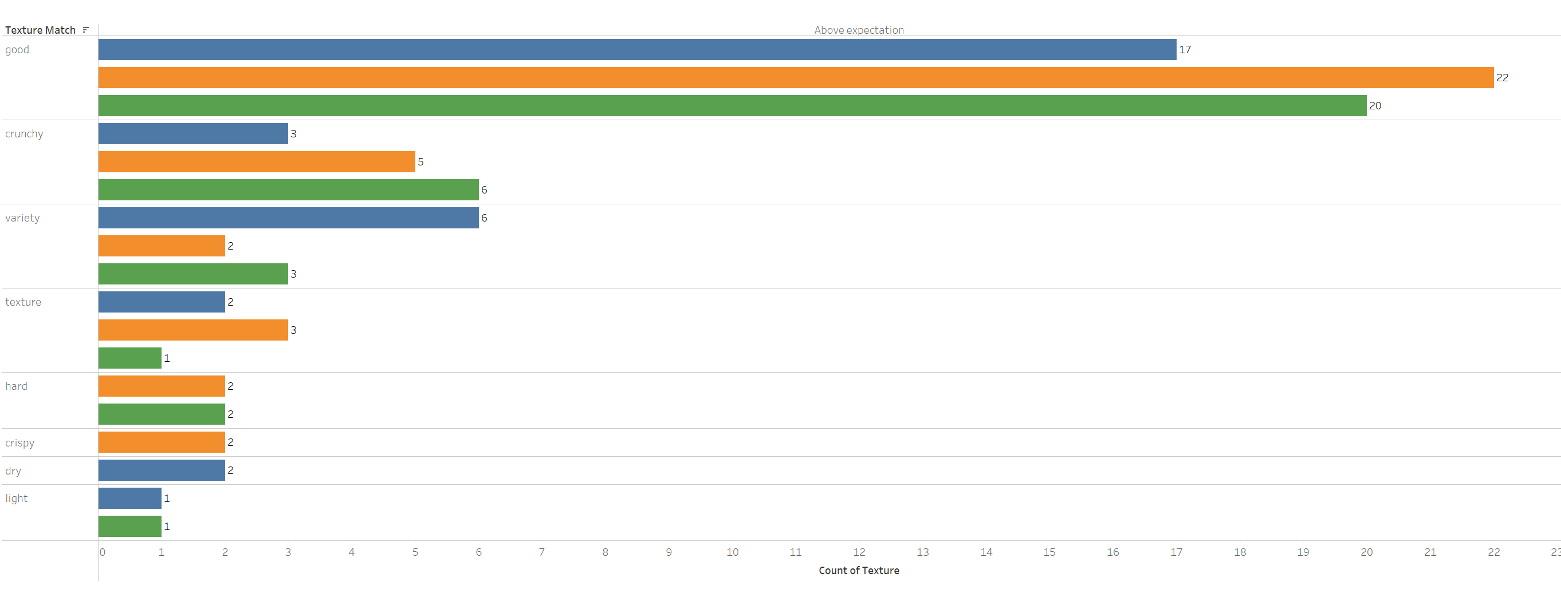
Topic Wise Breakdown – Texture (Meets Expectation)

Slide 7
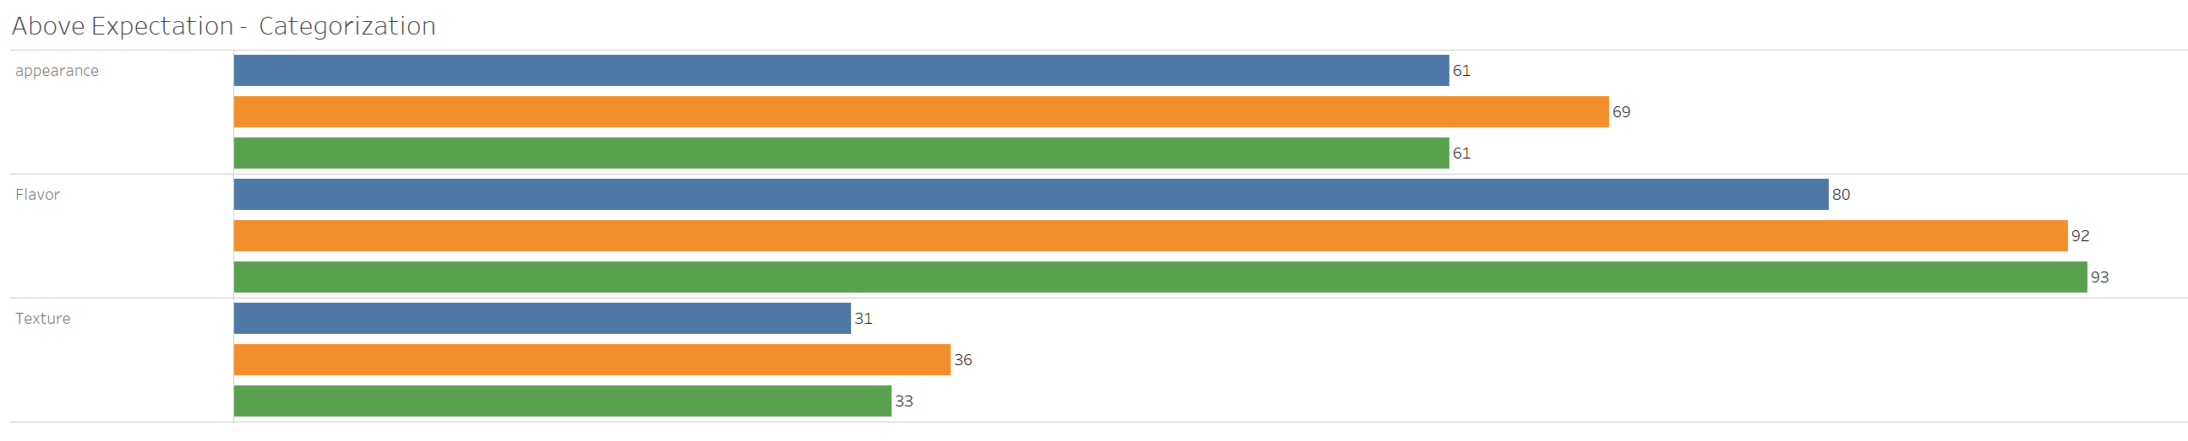
Exceeded Expectation – Topic Categorization

Slide 8
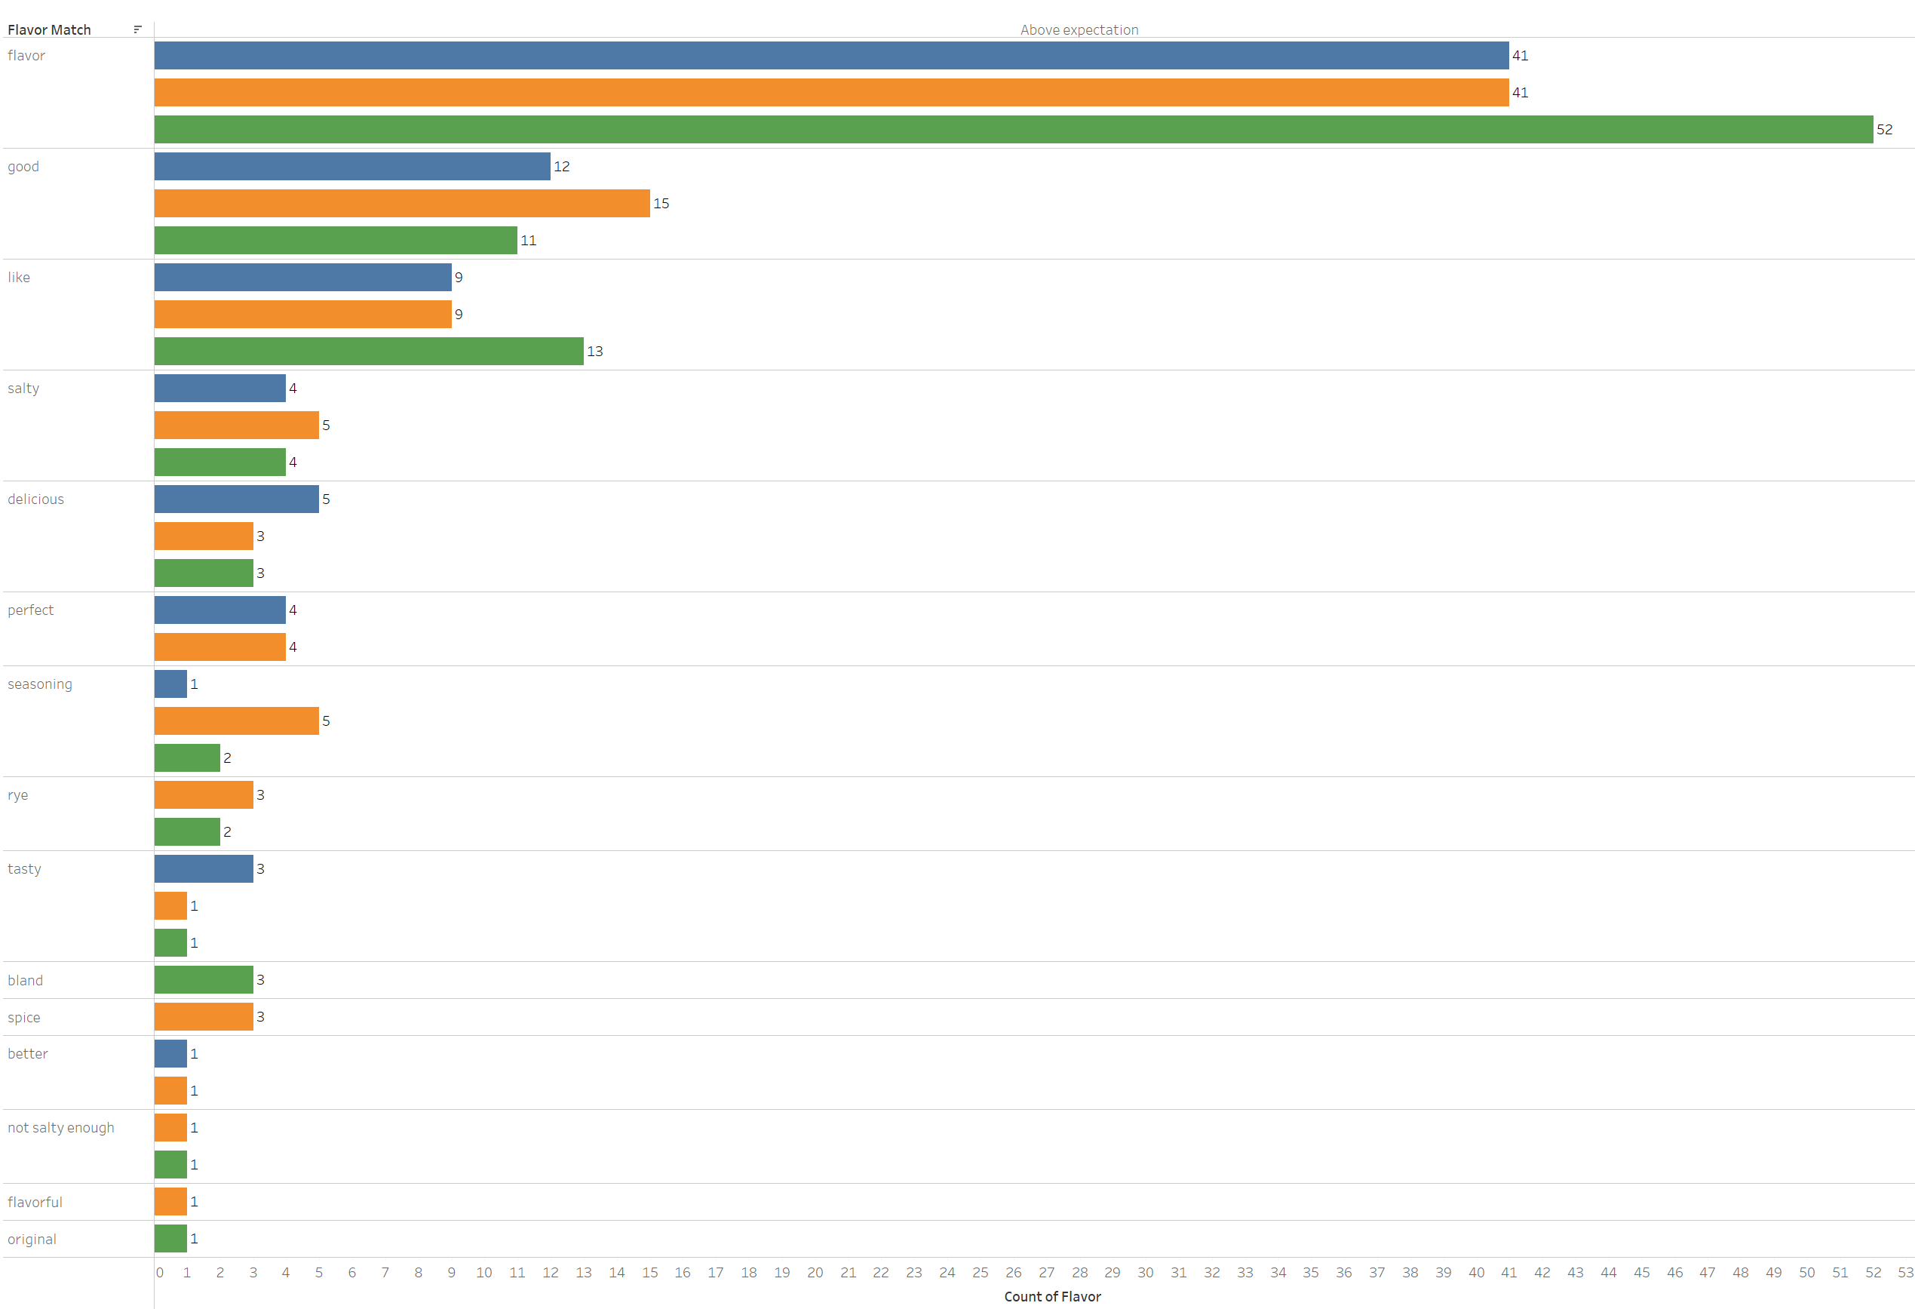
Topic Wise Breakdown – Flavor (Meets Expectation)

Slide 9
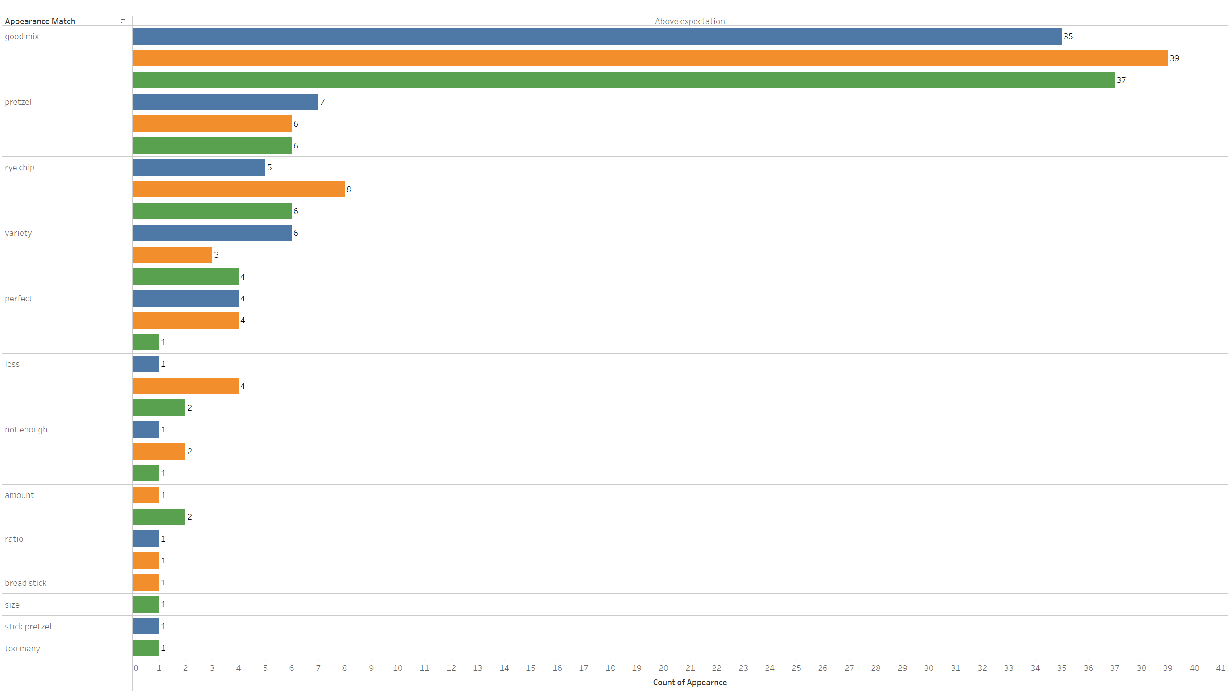
Topic Wise Breakdown – Appearance (Meets Expectation)

Slide 10
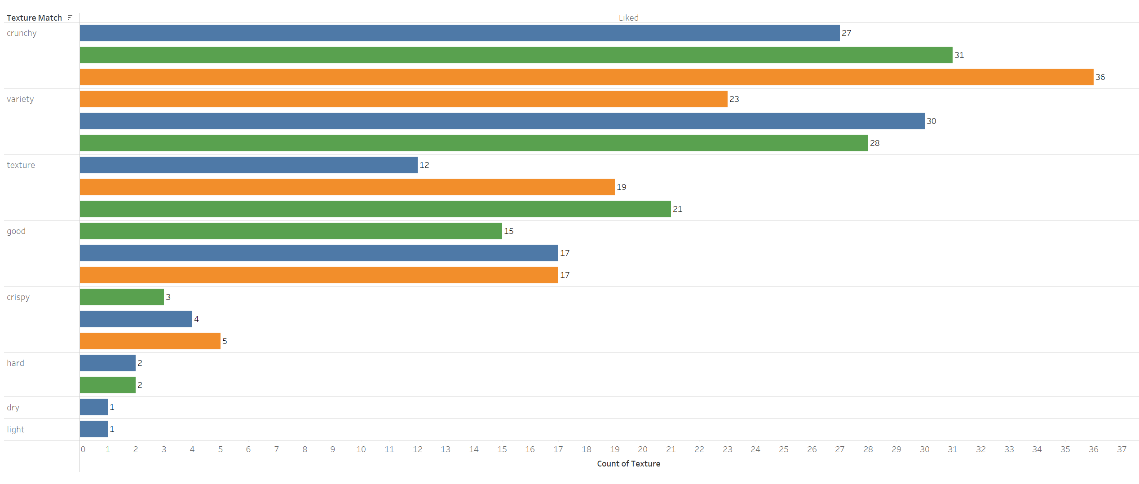
Topic Wise Breakdown – Texture (Meets Expectation)

Slide 11
Most Frequently words that appear together
Treehouse Micro Mini and Treehouse Stick
Pretzels Inc Micro Mini and Pretzels Inc Stick
Words | Frequency
Rye - chip | 47
Snack – mix | 10
Love – rye | 9
Bread – stick | 9
Different – type | 8
Words | Frequency
Rye - chip | 47
snack – mix | 14
Love – rye | 8
Chip – favorite | 8
Variety – item | 7
Treehouse Micro Mini and Treehouse Stick
Words | Frequency
Rye - chip | 49
Snack – mix | 9
Love – flavor | 9
Love – rye | 8
Chip – favorite | 8

